Slide 1
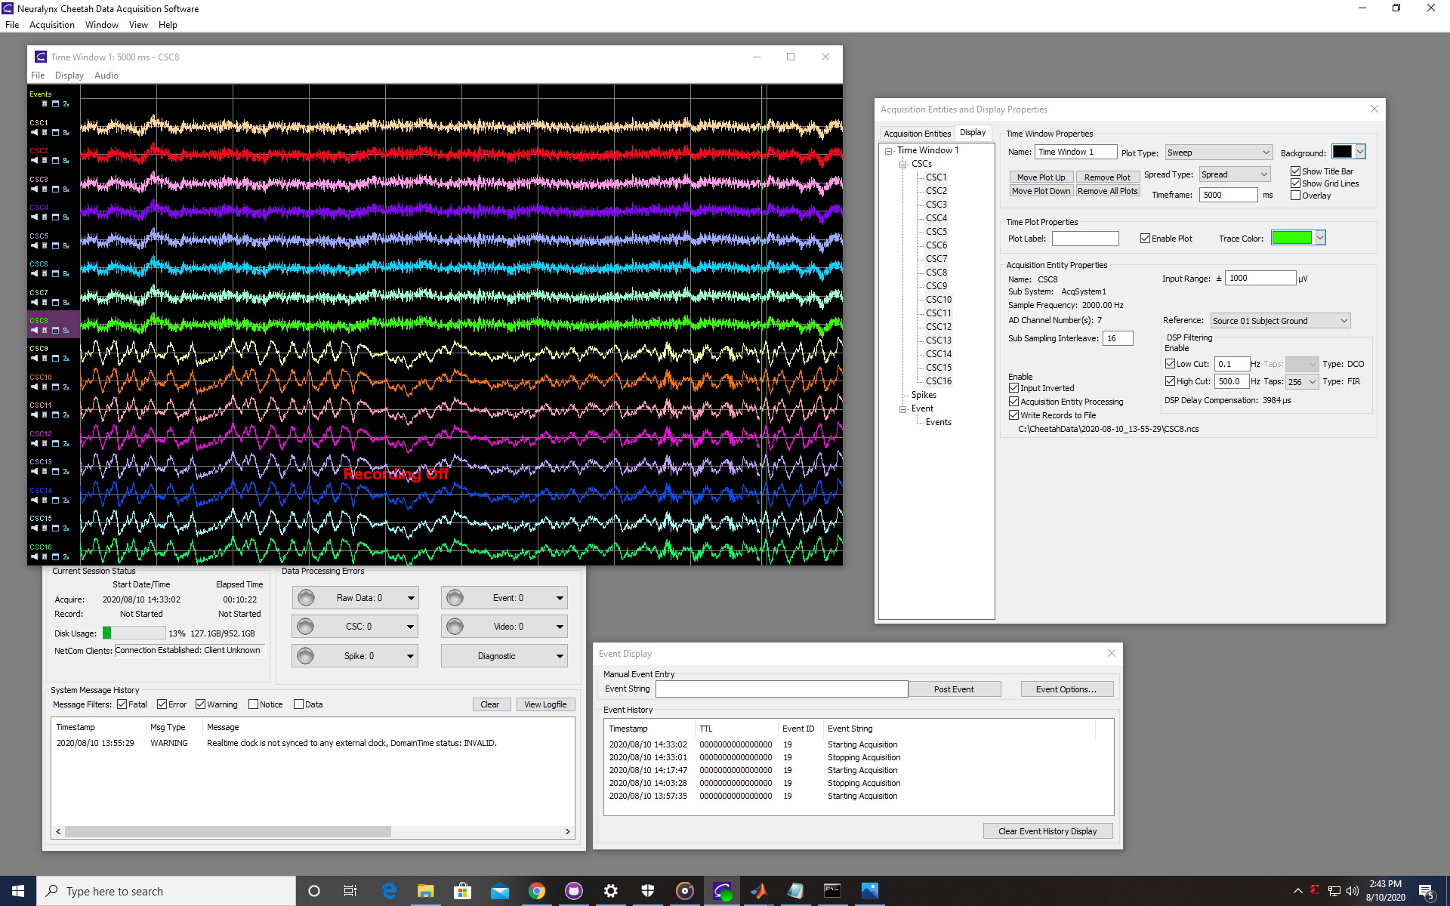
Example session with converted mPFC and HPC data being played through acquisition system

Slide 2
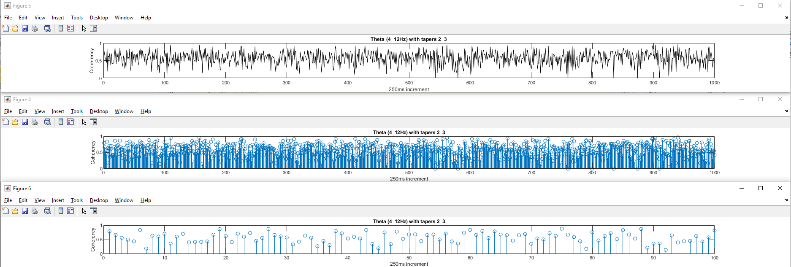
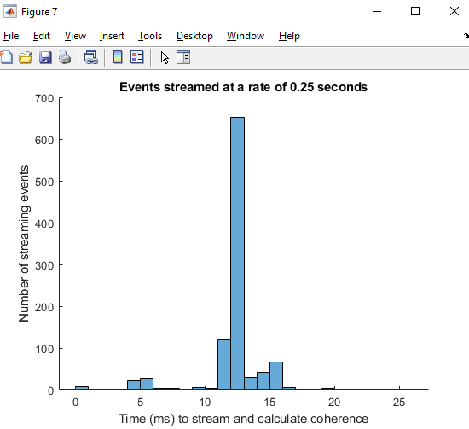
What is a suitable threshold for ‘High’ coherence?
Obtained with ‘time2calculateCoherence’

